Slide 1
Chapter Four
Combinatorics

Slide 2
Combinatorics
Combinatorics studies methods for counting combinations of objects. Usually, the goal is to find a way to count the combinations efficiently without generating each combination separately.
As an example, consider the problem of counting the number of ways to represent an integer n as a sum of positive integers. For example, there are 8 representations for 4:
1 + 1 + 1 + 1 2 + 2
1 + 1+ 2 3 + 1
1 + 2 + 1 1 + 3
2 + 1 + 1 4

Slide 3
Combinatorics
A combinatorial problem can often be solved using a recursive function. In this problem, we can define a function f (n) that gives the number of representations for n. For example, f (4) =8 according to the above example. The values of the function can be recursively calculated as follows: f (n) = 1 (n = 0)
f(n) = f (0) + f (1) +…+ f (n - 1) (n > 0)

Slide 4
Combinatorics
The base case is f (0) = 1, because the empty sum represents the number 0. Then, if n > 0, we consider all ways to choose the first number of the sum. If the first number is k, there are f (n - k) representations for the remaining part of the sum. Thus, we calculate the sum of all values of the form f (n - k) where k < n. The first values for the function are:
f(0) = 1
f(1) = 1
f(2) = 2
f(3) = 4
f(4) = 8

Slide 5
Combinatorics
Sometimes, a recursive formula can be replaced with a closed-form formula. In this problem, f (n) = 2^{n-1},
Which is based on the fact that there are n - 1 possible positions for +-signs in the sum and we can choose any subset of them.

Slide 6
Binomial Coefficients
A binomial coefficient C(n, k) can be defined as the coefficient of X^{k} in the expansion of (1 +X^{)n.}
A binomial coefficient C(n, k) also gives the number of ways, disregarding order, that k objects can be chosen from among n objects; more formally, the number of k-element subsets (or k-combinations) of an n-element set.

Slide 7
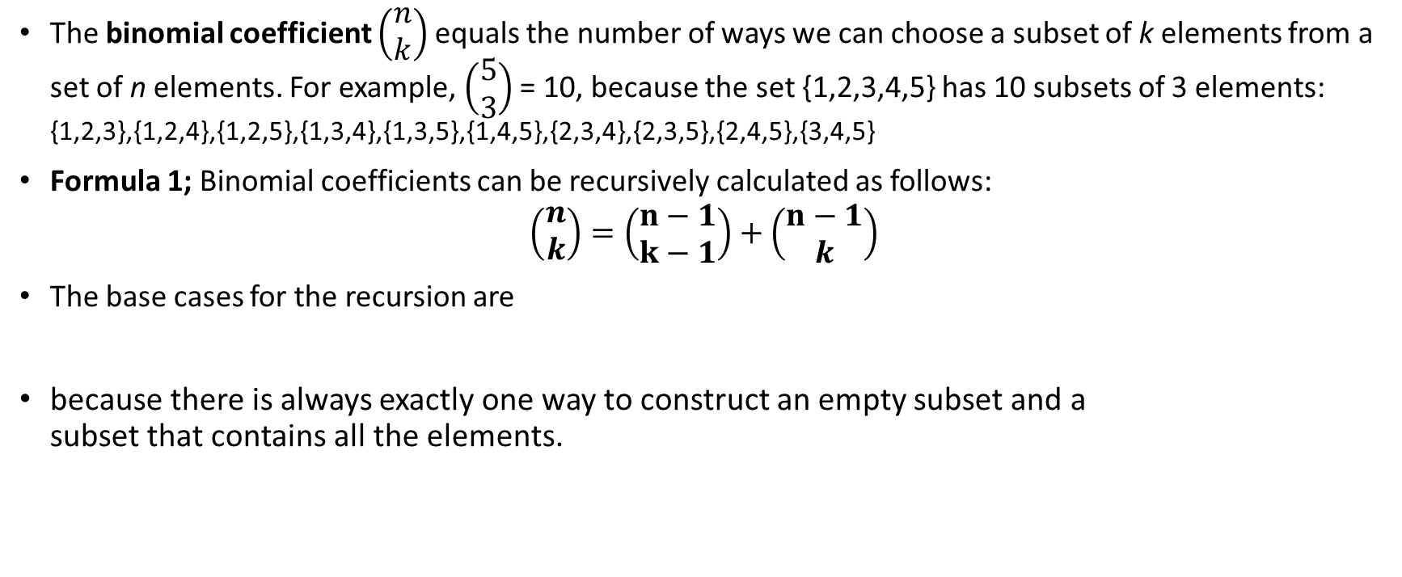

Binomial Coefficients

Slide 8
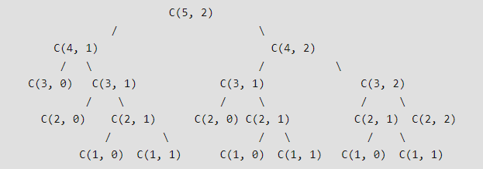
Binomial Coefficients
Or simply:
C(n, k) = C(n-1, k-1) + C(n-1, k)
C(n, 0) = C(n, n) = 1
Overlapping Subproblems It should be noted that the above function computes the same subproblems again and again. See the following recursion tree for n = 5 an k = 2. The function C(3, 1) is called two times. For large values of n, there will be many common subproblems.

Slide 9
Binomial Coefficients
Like other typical Dynamic problems, re-computations of same subproblems can be avoided by constructing a temporary array C[][] in bottom up manner.
int C[n + 1][k + 1];
int i, j;
for (i = 0; i <= n; i++) {
for (j = 0; j <= min(i, k); j++) {
if (j == 0 || j == i)
C[i][j] = 1;
else
C[i][j] = C[i - 1][j - 1] + C[i - 1][j];
}
}

Slide 10
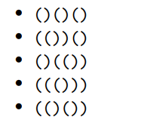
Catalan number
The Catalan number C_{n} equals the number of valid parenthesis expressions that consist of n left parentheses and n right parentheses. For example, C₃ = 5, because we can construct the following parenthesis expressions using three left and right parentheses:

Slide 11
Catalan number
Parenthesis expressions What is exactly a valid parenthesis expression? The following rules precisely define all valid parenthesis expressions: • An empty parenthesis expression is valid. • If an expression A is valid, then also the expression (A) is valid. • If expressions A and B are valid, then also the expression AB is valid.
Another way to characterize valid parenthesis expressions is that if we choose any prefix of such an expression, it has to contain at least as many left parentheses as right parentheses. In addition, the complete expression has to contain an equal number of left and right parentheses.

Slide 12

Catalan number
Formula 1: Catalan numbers can be calculated using the formula
C_{i}: the number of ways to construct an expression using the parentheses of the first part, not counting the outermost parentheses
C_{n-i-1}: the number of ways to construct an expression using the parentheses of the second part
The base case is C₀ = 1, because we can construct an empty parenthesis expression using zero pairs of parentheses.

Slide 13

Catalan number
Formula 2: Catalan numbers can also be calculated using binomial coefficients:

Slide 14
Generating permutuation using c++ library
int p[10], N = 10;
for (int i = 0; i < N; i++)
p[i] = i; do { for (int i = 0; i < N; i++)
cout << p[i] << « »;
cout << endl;
}while (next_permutation(p, p + N));

Slide 15
Generating all Sub-sets
Unfortunately there is no c++ library for generating all subsets.
We use a bit manipulation to achieve this which is very efficient.
int p[20], N = 20; for (int i = 0; i < N; i++) p[i] = i; for (int i = 0; i < (1 << N); i++) { //1<<N = 2^{N} for (int j = 0; j < N; j++){ if (i & (1 << j)) // if bit j is on cout << p[j]; // this is part of set
} cout << endl;
}

Slide 16
Iterating Combination
void printcomb(int n,int k, int s[], int Ssize, int i){
if(k == 0){
for(int x = 0; x < Ssize; x++) cout << s[x];
cout << endl;
return;
}
if(i > n) return;
S[Ssize++] = i;
printcomb(n, k - 1, Ssize, i + 1);
Ssize--;
printcomb(n, k, s, Ssize, i + 1);
}

